Slide 1
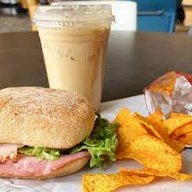

Lawson On-the-Go database management solutions
Session 1 - GROUP 2:
Poorna K Narasimhan
Prerana Das
Rupal Bilaiya
Sanjana Santhanakrishnan
Souradeep Chakroborty
Sree Kailash Ravichandar

Slide 2
AGENDA
TEAM INTRODUCTION
OBJECTIVE AND KEY TAKEAWAYS
DATABASE DESIGN
BUSINESS SOLUTION AND IMPACT
CONCLUSION

Slide 3






MEEt our team!
Poorna K
Narasimhan
Prerana Das
Rupal Bilaiya
Sanjana Santhanakrishnan
Souradeep Chakroborty
Sree Kailash Ravichandar

Slide 4
AGENDA
TEAM INTRODUCTION
OBJECTIVE AND KEY TAKEAWAYS
DATABASE DESIGN
BUSINESS SOLUTION AND IMPACT
CONCLUSION

Slide 5
Case overview and objective Problem Statement : Lawson OTG’s extensive meal options, long menus and speedy supply requires an efficient work-flow structure to cater to students need, working on employee management, shift allotment, food inventory management.
OBJECTIVE
DATASET
APPROACH
- Determine the data flow of multiple databases used by Lawson OTG
- Analyze data to find business solutions to the problem statement
- Create an effective inventory management system for OTG
Database consists of 11 tables (including 3 associative entity tables) and provides information of the food items and employees, such as orders, payments, quantities, categories, salaries, shift timings etc.
- Create the Entity-Relationship diagram and relational schema to understand the dataflow
- Perform exploratory analysis to understand business solutions that could help create an effective inventory management system

Slide 6




there are 3 KEY TAKEAWAYS from this project
Resource allocation and rationing is one of the more important aspects for any business to thrive. Managers at Lawson need to look into the uneven distribution of shifts and restructure the resource allocation keeping in the mind the varied trend in business demands across the week.
Inventory management and stock keeping is really important for a business that has varied demand everyday. Lawson should look into managing their inventory better as the ingredients for one of their bestselling items – Blooming Breakfast – are out of stock.
Lawson needs to make more products available under Meal Swipe as some items are available under Credit card only. As most items are sold at a higher price under Meal swipe, and since most people do not take the add-ons that come alongside, including more items under Meal Swipe will make Lawson more lucrative.

Slide 7
AGENDA
TEAM INTRODUCTION
OBJECTIVE AND KEY TAKEAWAYS
DATABASE DESIGN
BUSINESS SOLUTION AND IMPACT
CONCLUSION

Slide 8

data requirement of lawson otg
VENDOR DETAILS
PURCHASE DETAILS
EMPLOYEE DETAILS
ITEMS DETAILS
EMPLOYEE ROLE
PRODUCT CATEGORY
EMPLOYEE
SHIFT TIME
PRODUCT QUIANTITY
EMPLOYEE
SHIFT TIME
PRODUCT PRICING
ORDER DETAILS

Slide 9


NORMALIZATION OF TABLES AND DATABASE DESIGNING
1NF
2NF
START
Composite Variables normalized
- Prices
Partial Functional Dependencies removed
Vendor Name
Role, Salary
3NF
11 tables created
Transitive Dependencies removed
- Product Name, Meal Price, Credit Price
FINISH
Data formatted
- Formatted to CSV
- Uploaded in SQL

Slide 10

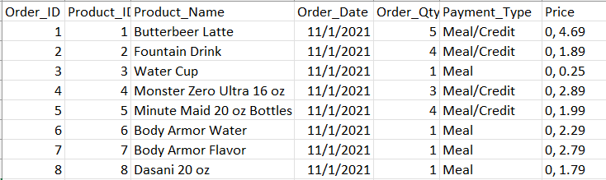
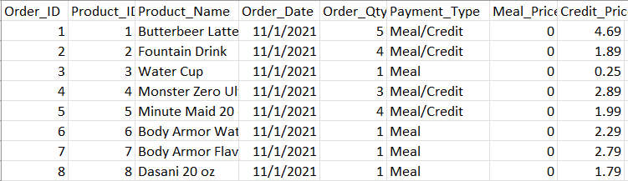
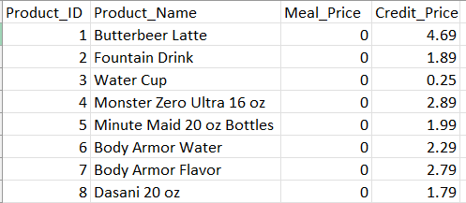
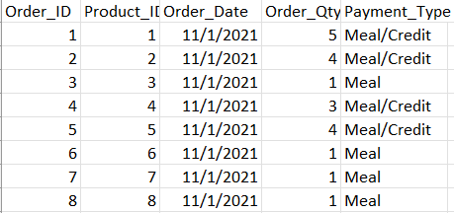
NORMALIZATION - ORDERS
0NF
2NF
3NF

Slide 11
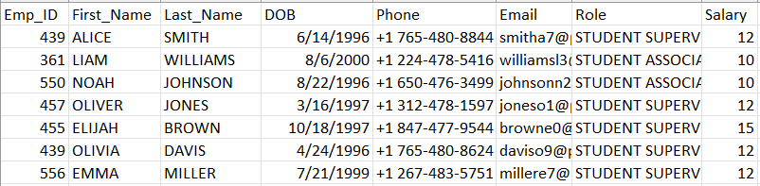
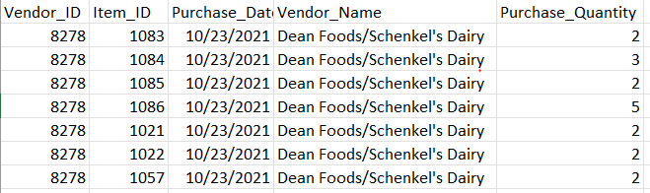
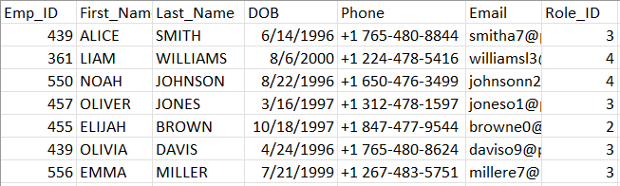
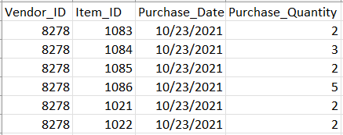
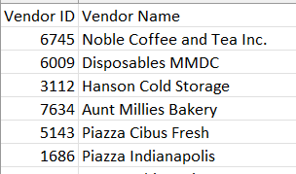
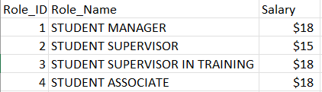
NORMALIZATION – EMPLOYEE AND VENDOR_ITEM
2NF
1NF
3NF
3NF

Slide 12
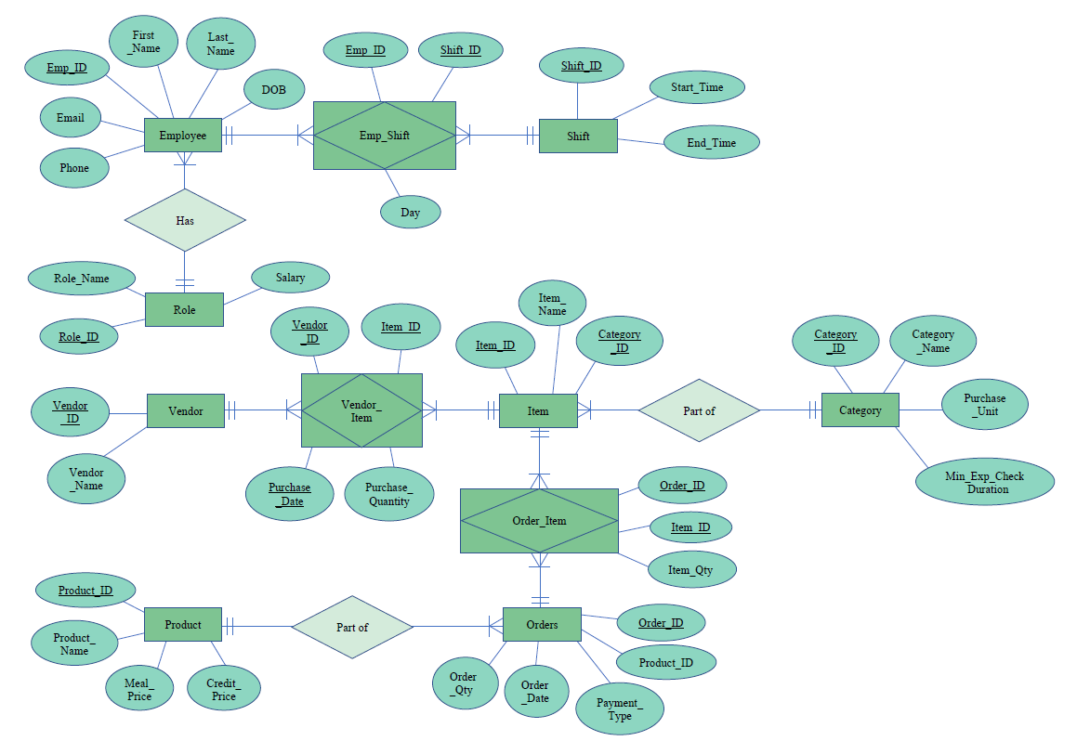

ENTITY RELATIONSHIP DIAGRAM

Slide 13
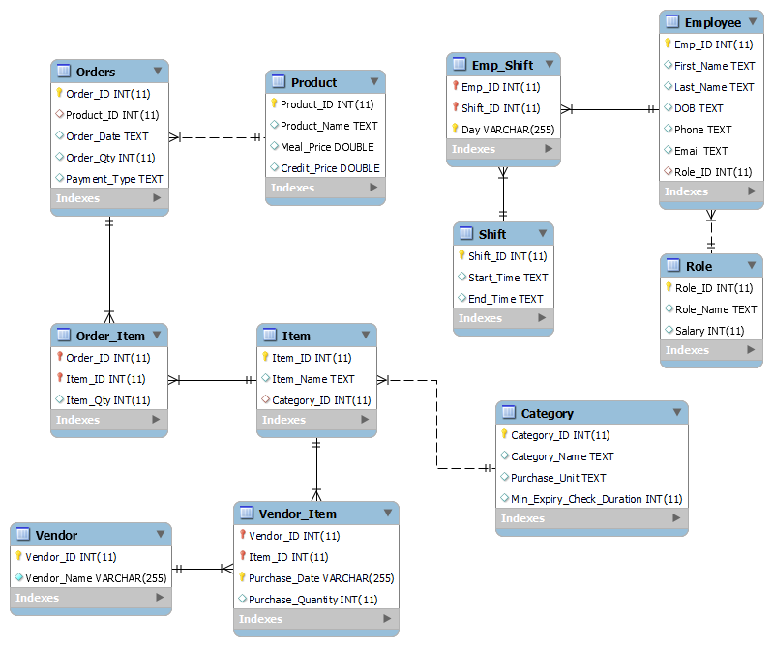
DATA WAREHOUSE

Slide 14
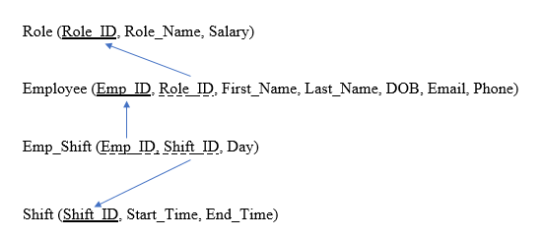

Employee-shift RELATIONAL SCHEMA

Slide 15
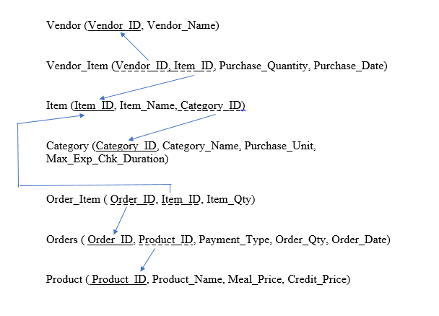

Vendor-food inventory-pricing RELATIONAL SCHEMA

Slide 16
AGENDA
TEAM INTRODUCTION
OBJECTIVE AND KEY TAKEAWAYS
DATABASE DESIGN
BUSINESS SOLUTION AND IMPACT
CONCLUSION

Slide 17


Before moving ahead, let’s discuss the business questions we will address today!
BUSINESS QUESTIONS:
Is the current shift-wise distribution of employees in keeping with the daily demand? Does it require a change?
Are the employees being used to their full capacity?
What is the average daily sales in Lawson OTG?
Which are the two days that are the busiest?
What are the food items that are most and least in-demand?
What are the recommended best-selling combinations?
How is the resource planning and management to account for food inspection and expiry?
Which item and category should be replenished soon based on the difference between order quantity and supply quantity?
What is the most frequent payment mode?
Which vendors supply the categories of items that are purchased the most ordered by the quantity they supply and frequency they supply?

Slide 18

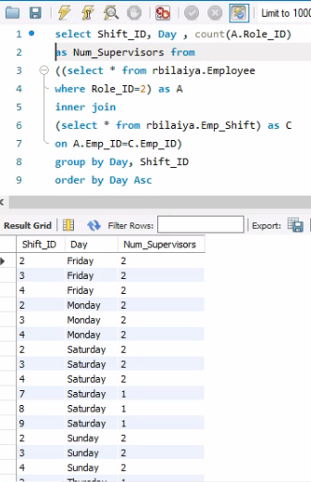
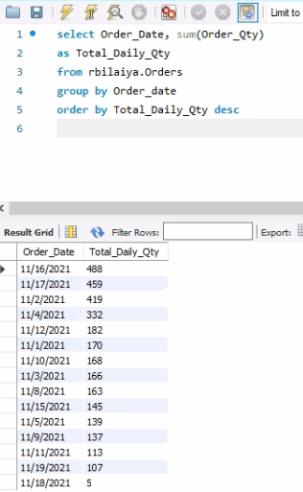
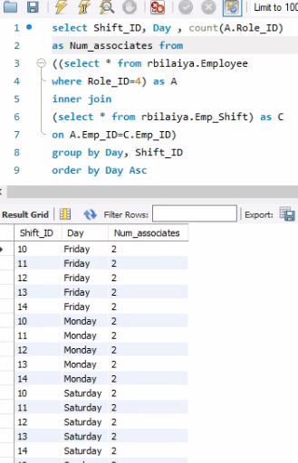
1. Is the current shift-wise distribution of employees in keeping with the daily demand? Does it require a change?
SQL CODE AND SOLUTION:
INSIGHTS AND RECOMMENDATION:
Efficient and optimum distribution of employees with respect to the demand or rush in the Dining Hall is a pertinent problem.
For every shift, there are two supervisors and two associates consistently across all days.
But daily demand is dynamic. It ranges from 488 to merely 5 on certain days.
Therefore, Lawson requires better distribution of resources
Query1: Number of Supervisors
Query3: Total Daily Order Quantity
Query2: Number of Associates

Slide 19
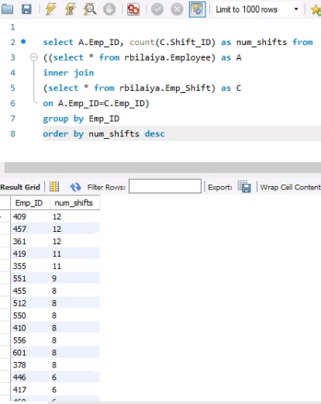
2. Are the employees being used to their full capacity?
SQL CODE AND SOLUTION:
INSIGHTS AND RECOMMENDATION:
The distribution of shifts amongst the employees doesn’t seem to be done in the most efficient manner.
There are certain employees covering as high as 12 shifts in working week whereas certain others are covering for just 1-2 shifts.
The business needs to make more equal distribution of workload and shifts to achieve better efficiency and reduce workload (i.e., put a capping to number of shifts).
Query1: Number of Shifts done by every Employee

Slide 20
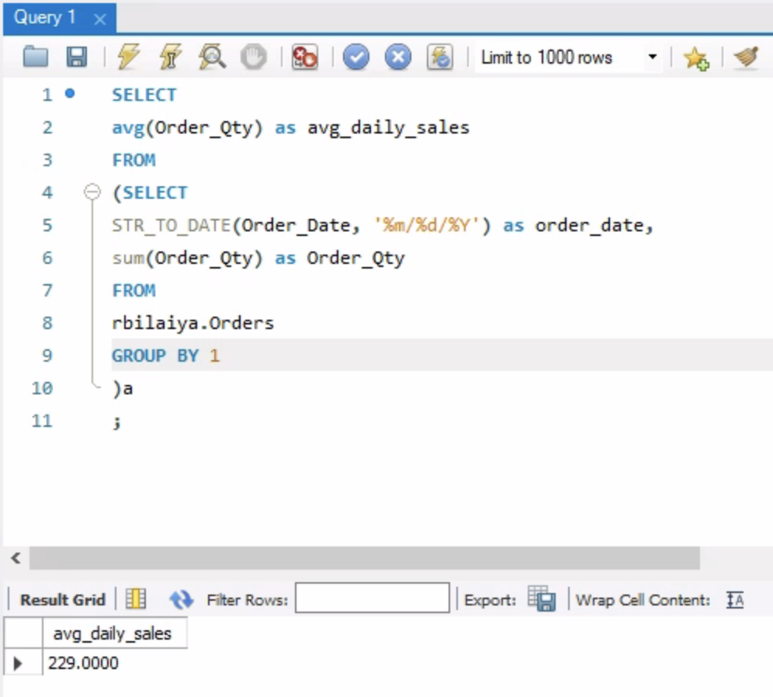
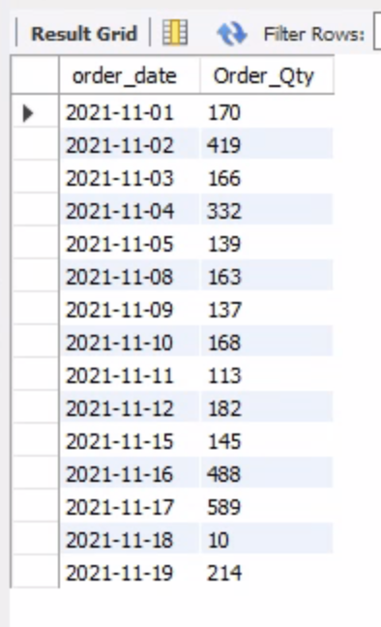
3. What is the average daily sales in Lawson OTG?
SQL CODE AND SOLUTION:
INSIGHTS AND RECOMMENDATION:
There is a high variation in the order quantities across dates
Even though the average daily sales is 229, it is not recommended to go with this number while planning inventory for a day because of the fluctuations
The footfall, and hence order quantity depends on multiple other factors ranging from local festivals, games, exams and other factors.
It is recommended to plan inventory for 3-4 days in advance
Query1: Average Daily Sales
Query2: Order quantity by date

Slide 21
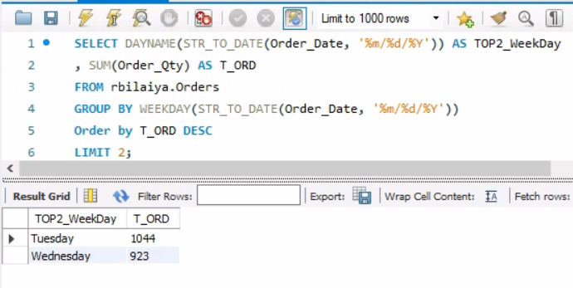
4. Which are the two days that are the busiest?
SQL CODE AND SOLUTION:
INSIGHTS AND RECOMMENDATION:
We can see highest number of orders are placed on Tuesday and Wednesday compared to rest of the working days.
As analyst we suggest having a greater number of backups and more employees to handle the workload on these 2 days.
Query1: Total # of orders in the top 2 busiest day

Slide 22
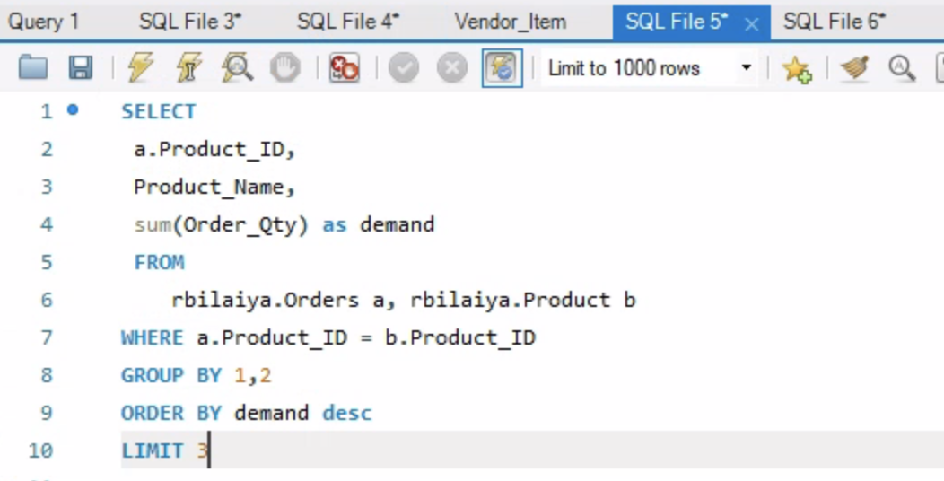
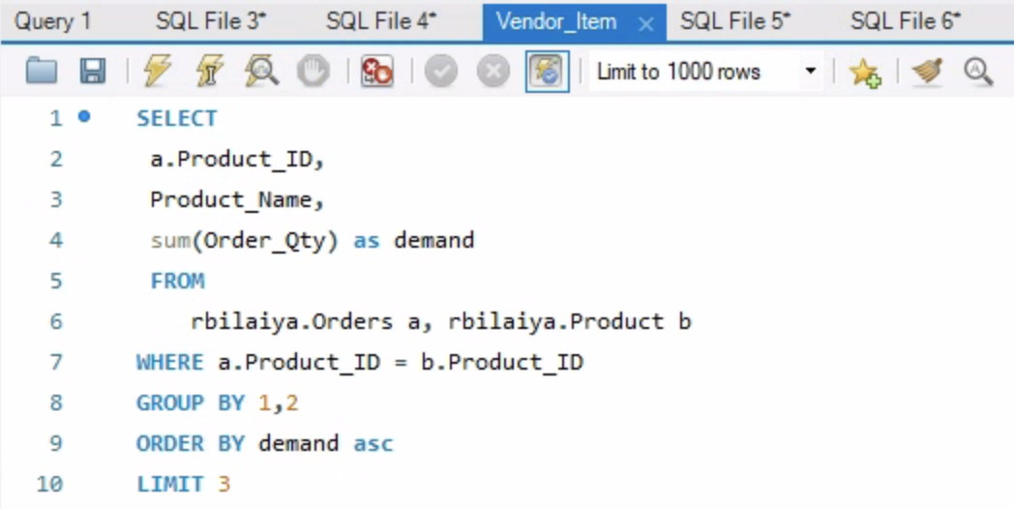
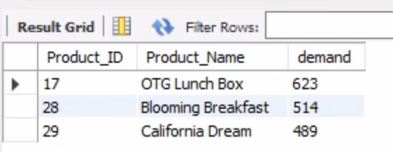
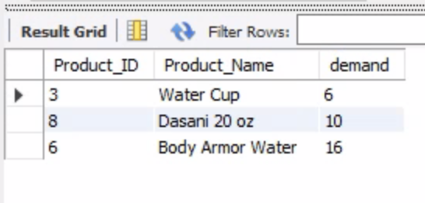
5. What are the food items that are most and least in-demand?
SQL CODE AND SOLUTION:
INSIGHTS AND RECOMMENDATION:
It is clear that OTG lunch box and Blooming Breakfast are the most in-demand products. The former is there because of the short time it requires to get it ready while the latter is present because of the customizability.
Water is not in demand much which suggests that we need manage the inventory of the same frequently and since it does not go bad in a short time, it could be purchased at bulk.
Query1: Most in-demand products
Query2: Least in-demand products

Slide 23
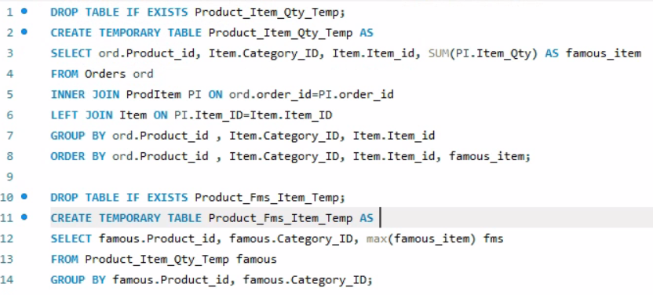
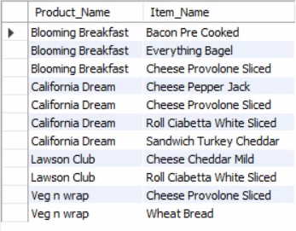
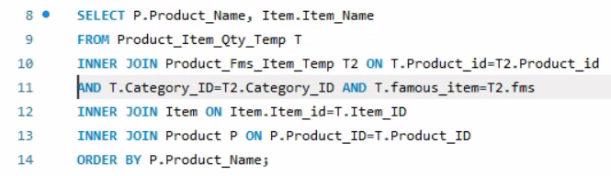
6. What are the recommended best-selling combinations?
SQL CODE AND SOLUTION:
INSIGHTS AND RECOMMENDATION:
According to our analysis, we recommend Lawson to high stock of provolone cheese as it is the bestselling item for 3 products.
In case of breads, white bread and everything bagels are the most used items.
Query1: Combination of products and item in famous category
Query2: Filter best combination for every product

Slide 24
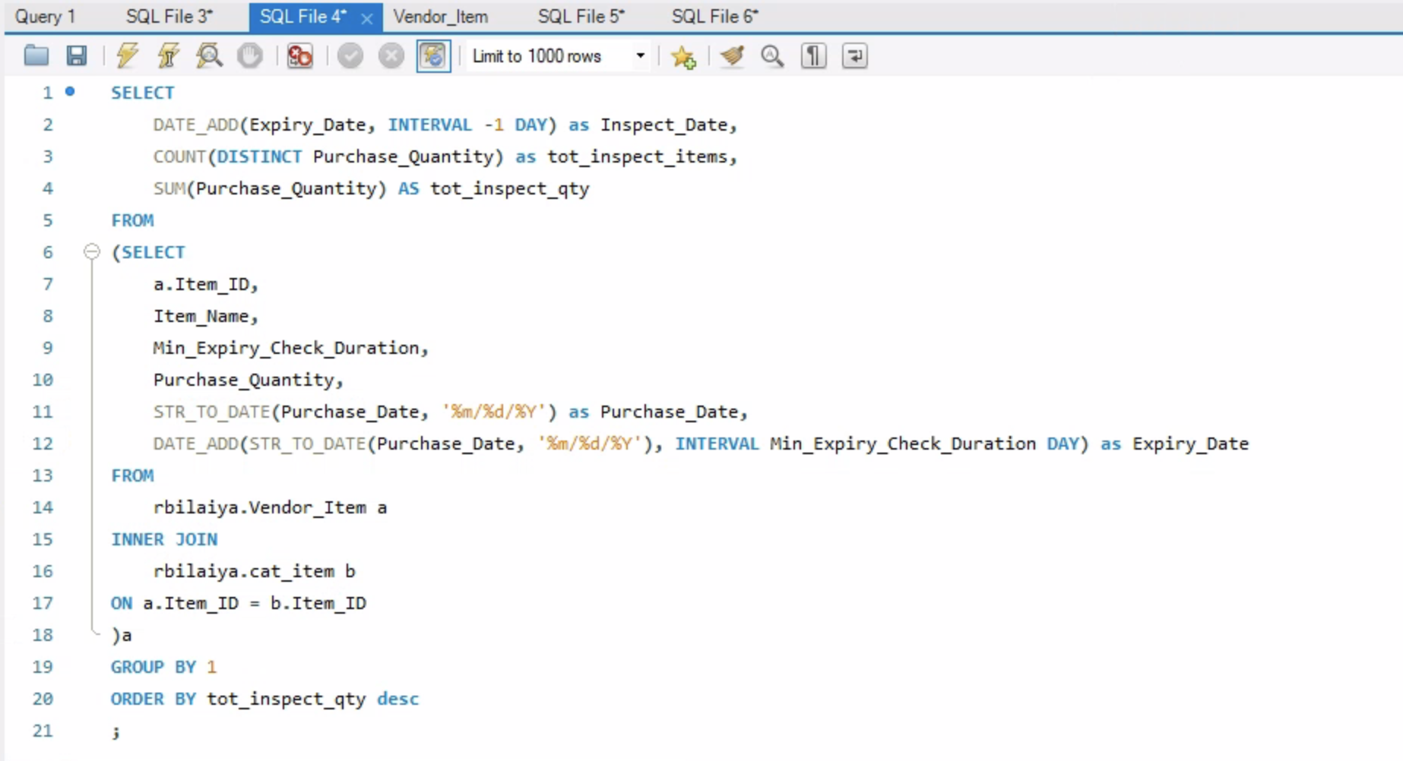
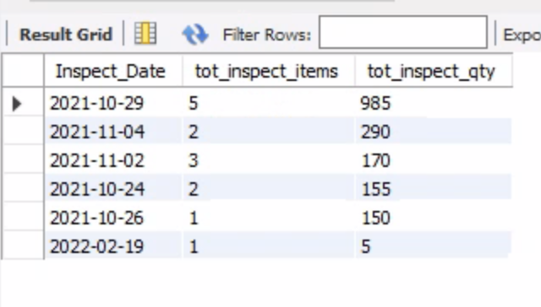
7. HOW IS THE RESOURCE PLANNING AND MANAGEMENT TO ACCOUNT FOR FOOD INSPECTION AND EXPIRY?
SQL CODE AND SOLUTION:
INSIGHTS AND RECOMMENDATION:
Inspection date is usually the day before the stated expiration date of an item
29th October and 2nd November seem to be the busiest days when it comes to checking for item spoilage, hence may require a resource to clock longer hours than usual
We see a total of 5 items that need to be checked for quality on 29th October which may entail new inventory purchase, hence inventory management should take this into consideration
Query1: # of items and quantity by inspection date

Slide 25
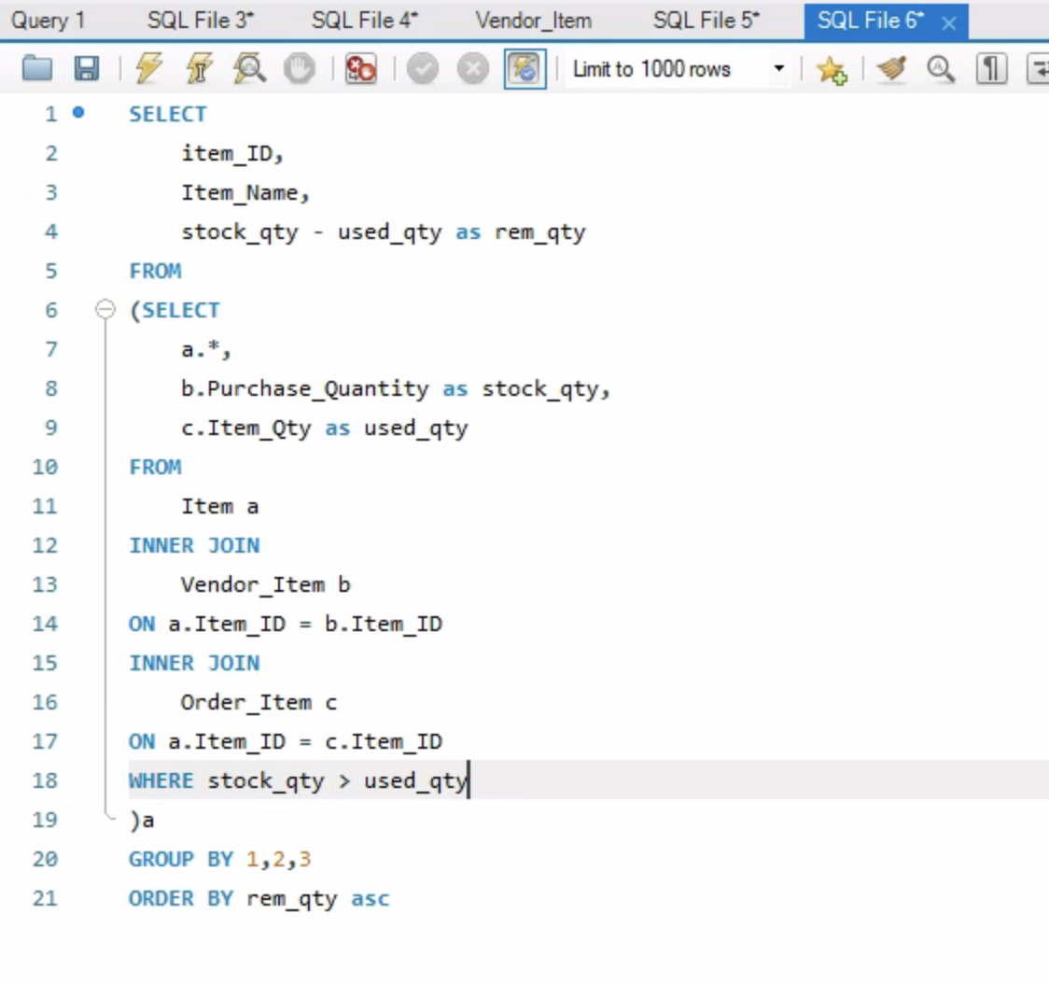
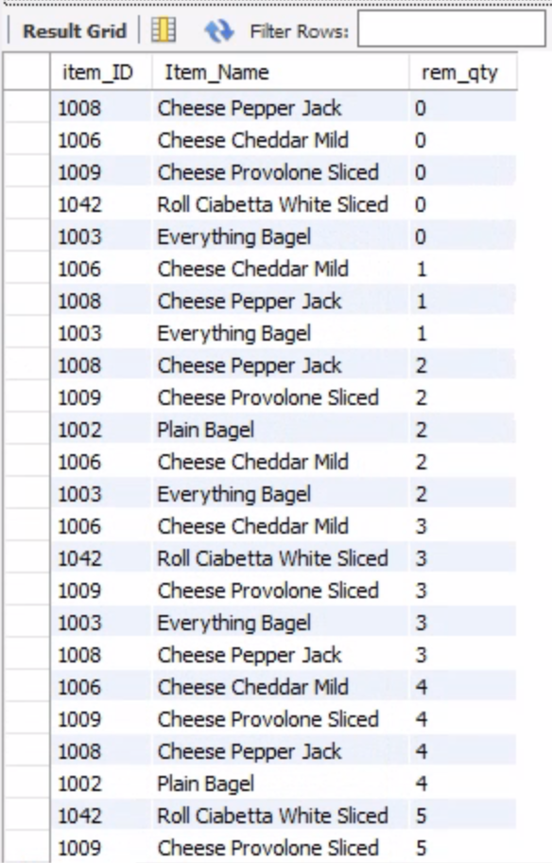
8. Which item should be replenished soon based on the difference between order quantity and supply quantity?
SQL CODE AND SOLUTION:
INSIGHTS AND RECOMMENDATION:
It is crucial to check for out of stock quantities in order to prevent items from being excluded from the menu, and hence maximize the revenue.
From the snippet, it is clear that cheese and bagel are running out of stock which puts the breakfast sandwiches part of the menu at risk.
Also, this could be automated as it is important to check for quantities of items that might run out of stock soon
Query1: # of items that are running out of stock

Slide 26
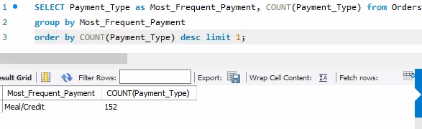
9. What is the most frequent payment mode?
SQL CODE AND SOLUTION:
INSIGHTS AND RECOMMENDATION:
It is apparent that the most popular payment method is the Meal/Credit.
This essentially means that a particular food item has been sold via Meal swipes as well as cards.
While some items are limited to just meal swipes and others to just cards, it will draw in more of a buyer base if items are made available under both the categories.
Query1: Most frequent payment mode

Slide 27
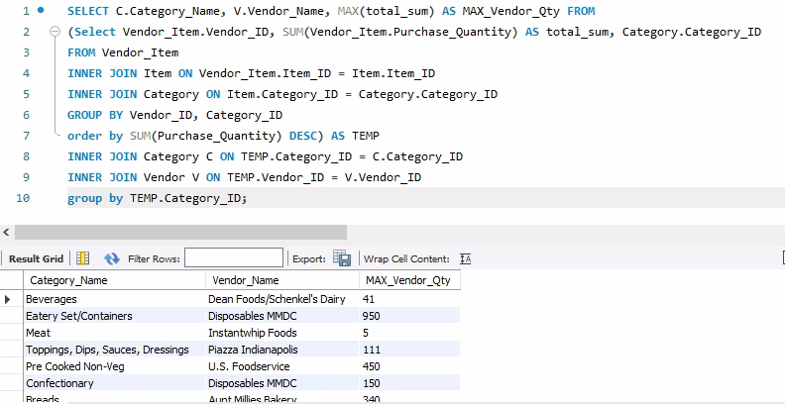
10. Which vendor makes most of the deliveries? What are the food items they provide?
SQL CODE AND SOLUTION:
INSIGHTS AND RECOMMENDATION:
As a result, we get a list of the categories where a particular vendor supplies the maximum quantity.
This will help us choose the best vendor to make a purchase from the next time a product under a particular category has to be purchased since it’s clearly ordered in a large quantity in comparison.
Query1: Highest quantity supplying vendor for every category

Slide 28

RECOMMENDATIONS
Employees to be put on shifts based on the level of food order demand in the week, instead of uniform distribution
Daily inventory should be checked to take care of days where multiple items are required in advance. A recurring reminder in calendar to order would help
All the menu options should be provided on both meal swipe and credit card options as both are very widely and extensively used while ordering
Having a list of vendors for specific food items in bulk should be provided to the management staff including student manager for crisis management

Slide 29

improvements
The tally of inventory utilization is updated at a daily level after taking stock of the inventory in the end. This could be automated by doing it at a transaction level.
A link between employee and orders table is not present. This could be added for more effective human resource management.
Stored procedures could be implemented to automatically calculate the expiry duration of items at a daily level.
Beverages are very customizable and the same can be implemented in our database as it is designed to scale.

Slide 30

Thank you!
Any Questions?

Slide 31
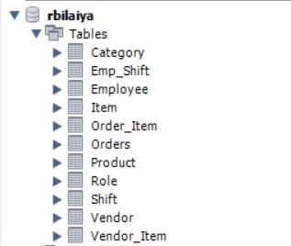
APPENDIX Table view

